Slide 1
Group 13
Academic Planner
Aayush Dakwala
Amandeep Singh
Fahim Zaman
Meet Sinojia
Pankti Patel

Slide 2
Meetings
With Client and TA – Once a week
Internal – Twice a week

Slide 3
Meetings With Client Team
Feb 1 - first meeting. Communicated future plan (eg. sprint length), and what tech stack we plan to use.
Feb 7 - client team shared the requirements list.
Feb 14 - showed our jira board to clients. Told them the plan for the next 2 sprints.
Feb 21 - cancelled due to reading week, but shared updates via teams (on login, signup features).

Slide 4
Roadmap
Sprint 0: (To begin the development)
Database design, JIRA setup, VM setup and learning of development technologies
Sprint 1: (Developed)
Login, Signup and user authorization (Email Verify Link) and authentication (JWT)
Sprint 2: (Ongoing)
Profile set up by collecting data such as planned timings, essential timings and part time job timings.

Slide 5
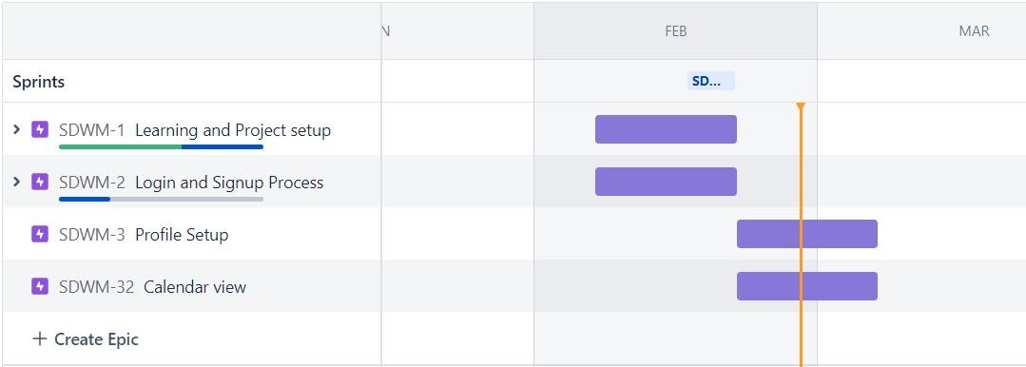

Slide 6
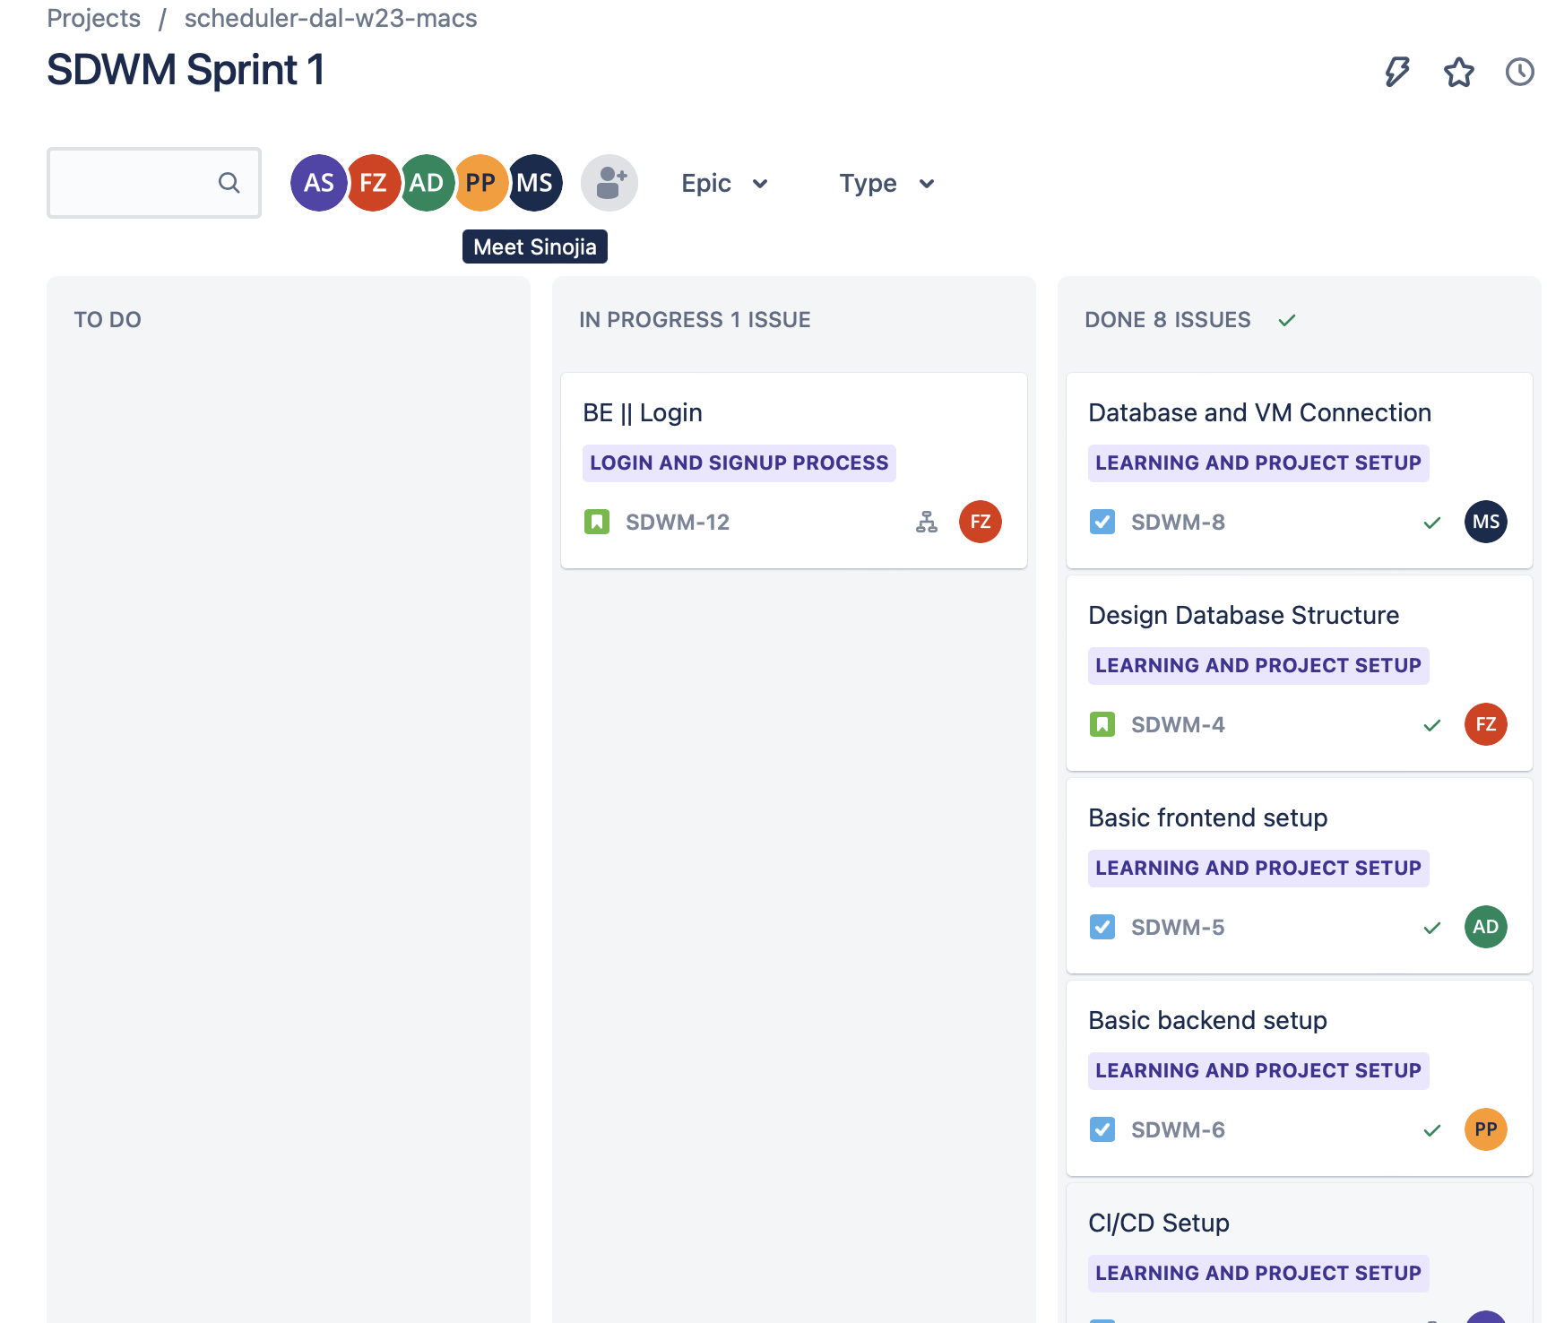
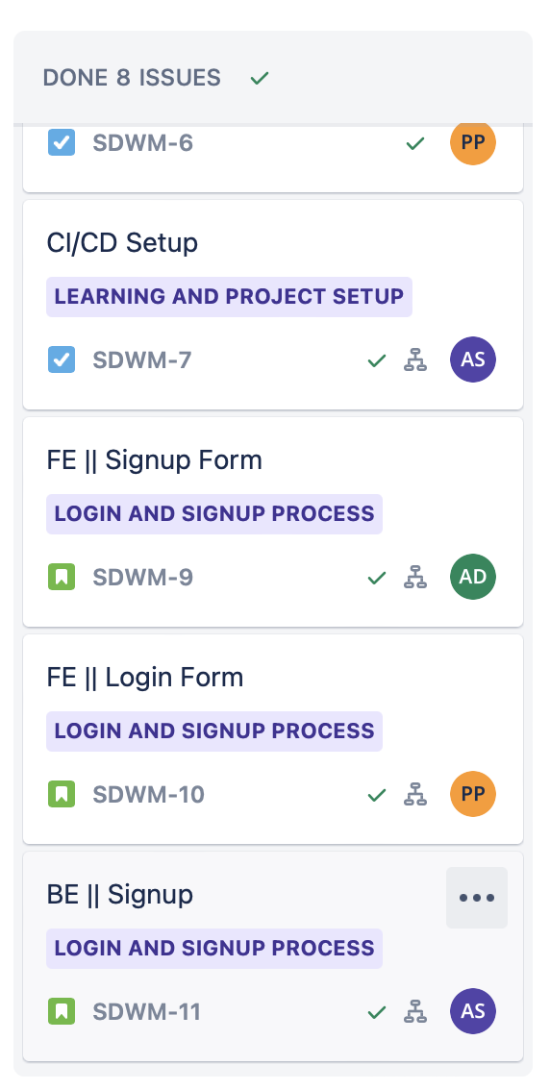
Jira Board

Slide 7
Tasks completed
Sprint 1:
Learn Technologies and practice it
CI/CD pipeline for continuous integration
Implement Login and signup
Sprint 2:
Verification for new user through email
Profile set after successful signup

Slide 8
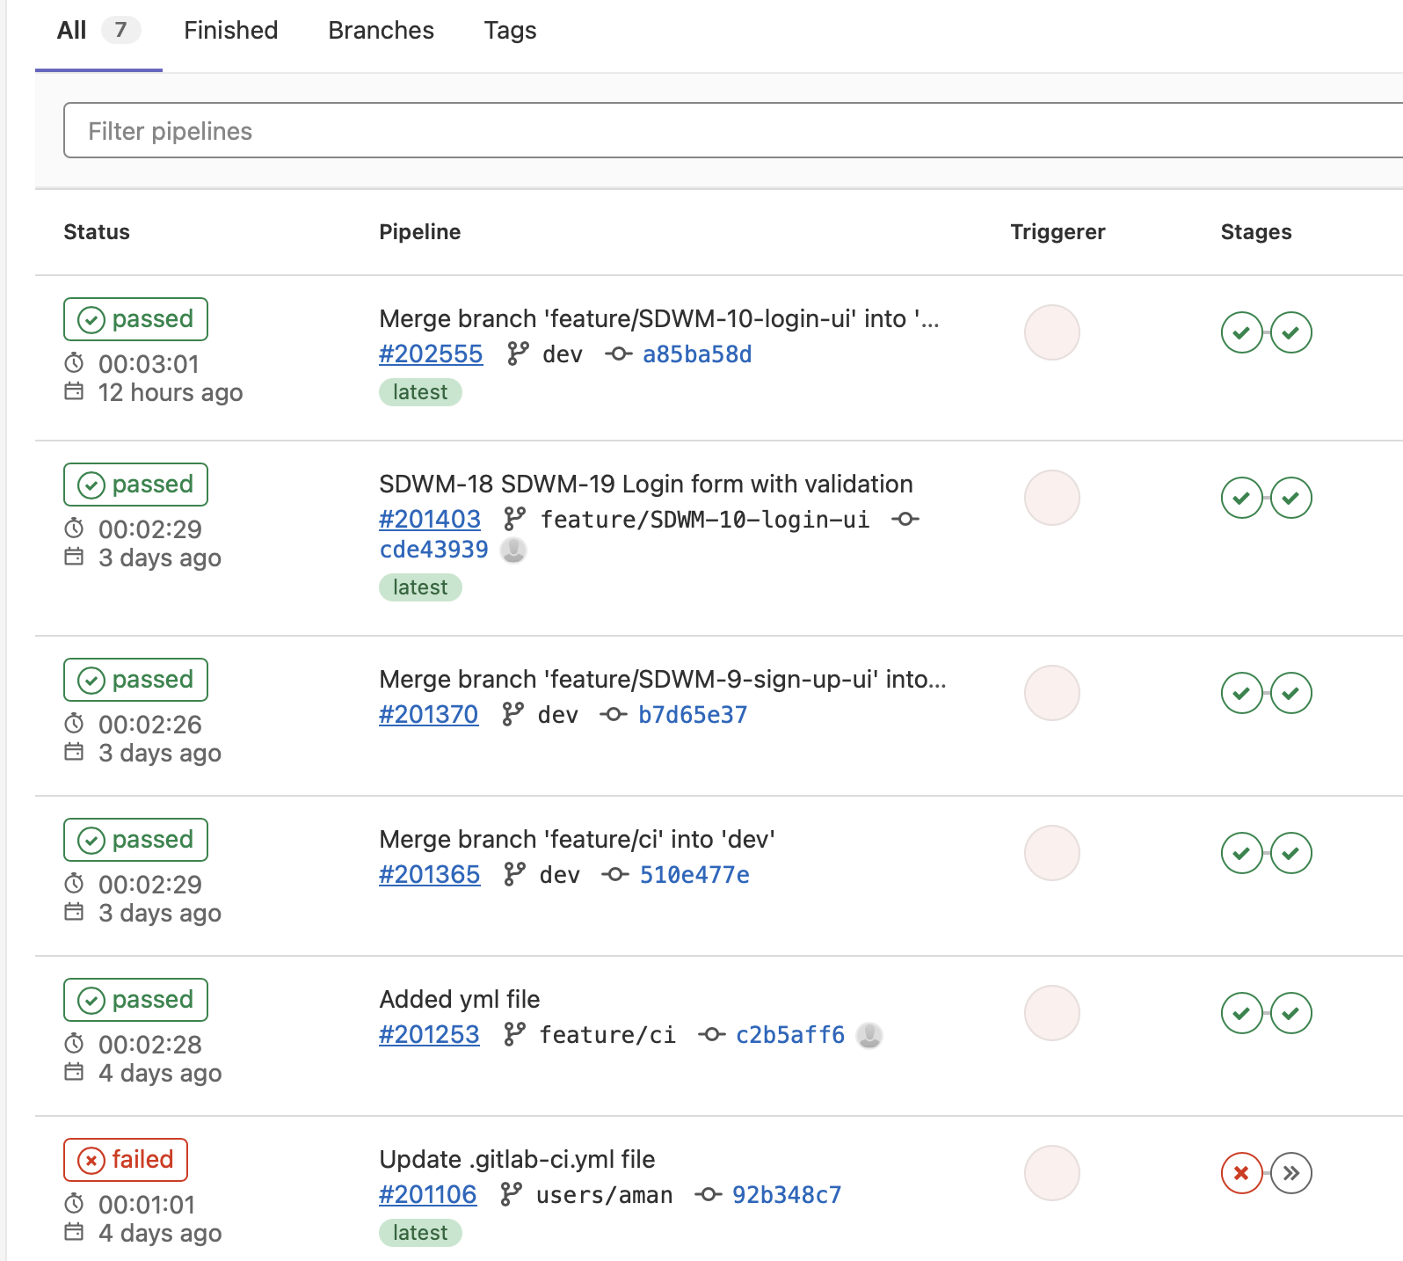
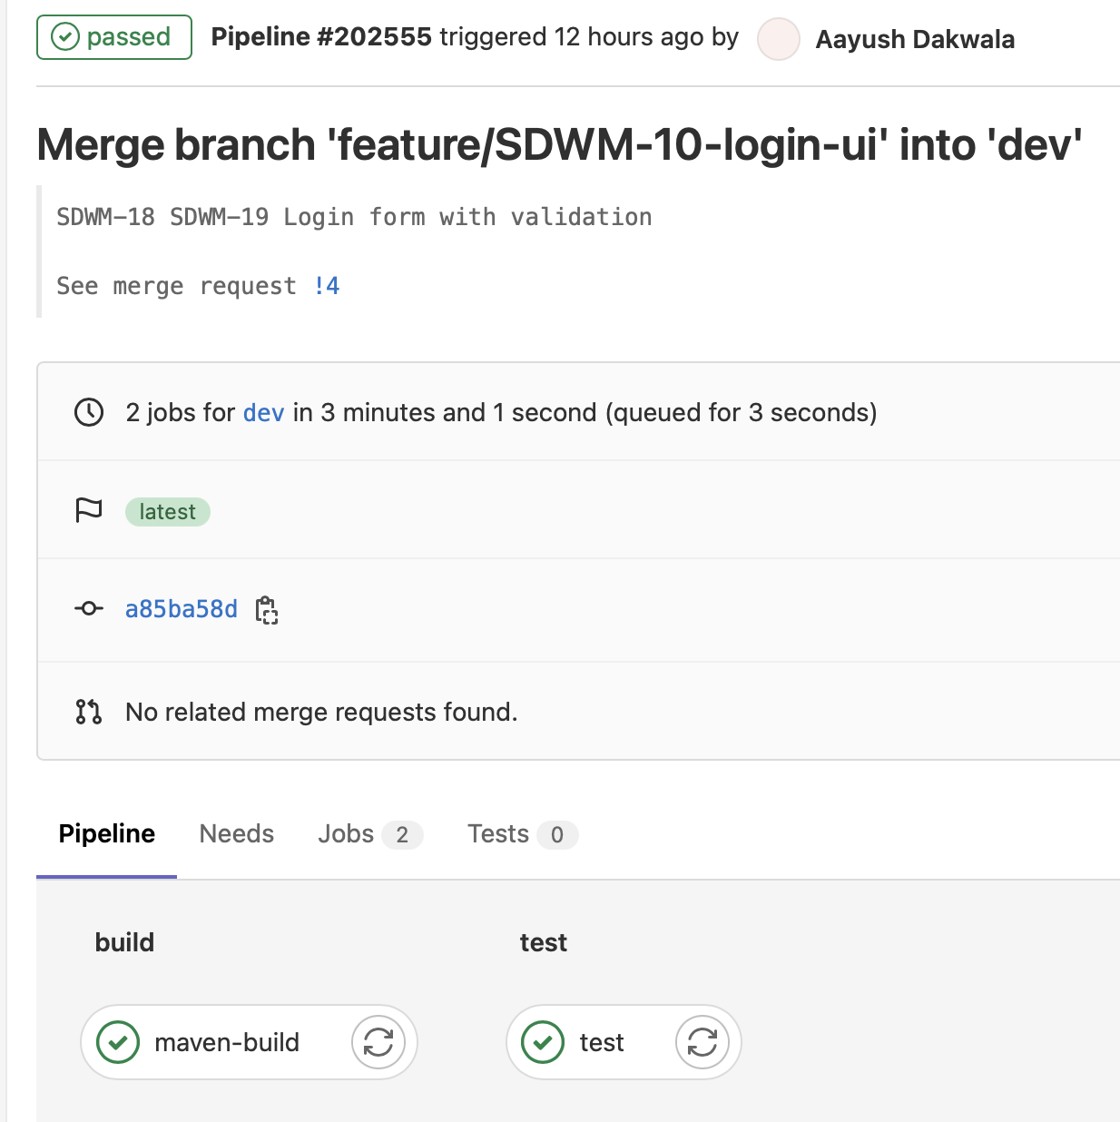
Continuous Integration

Slide 9
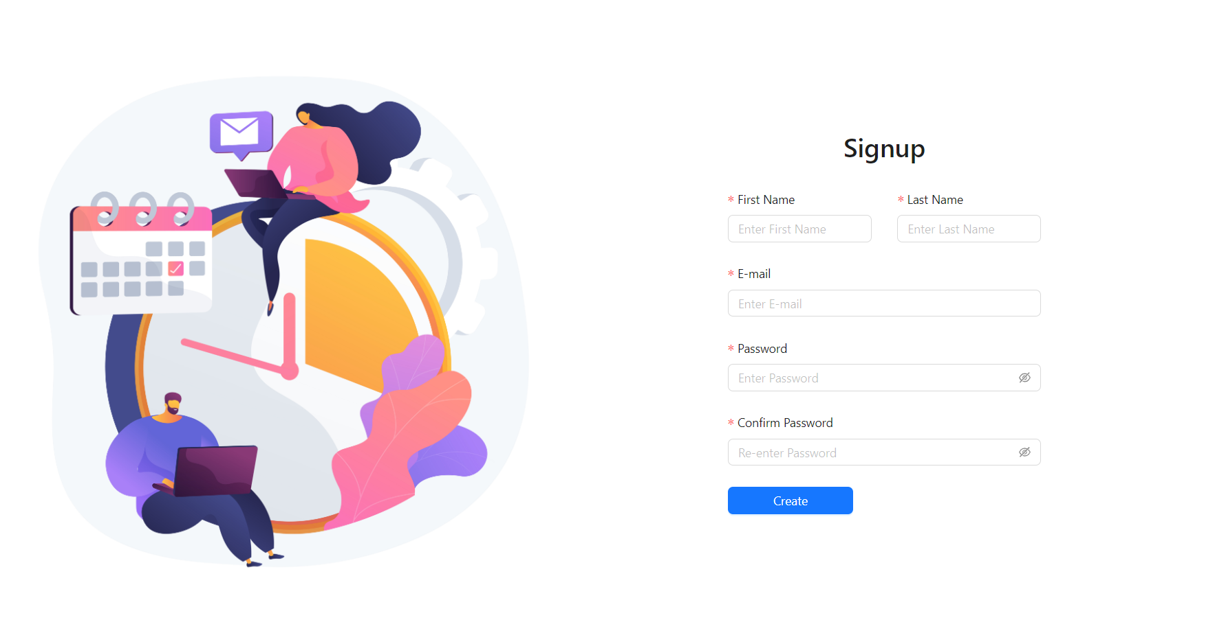

Slide 10
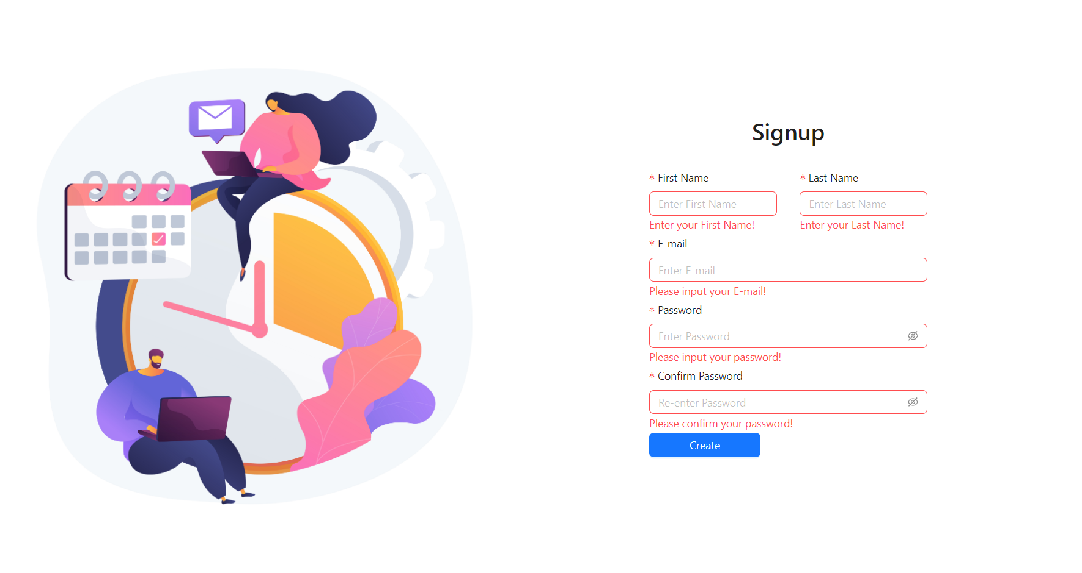

Slide 11
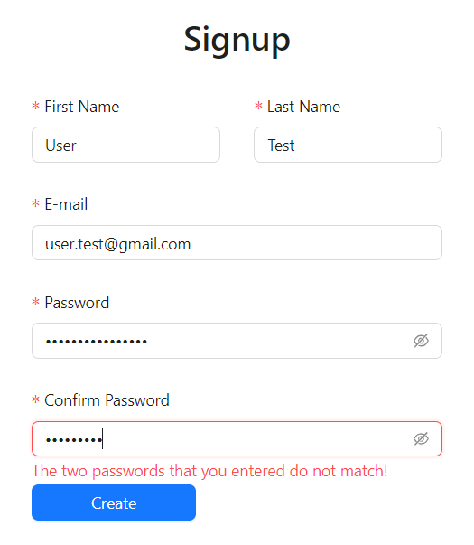

Slide 12
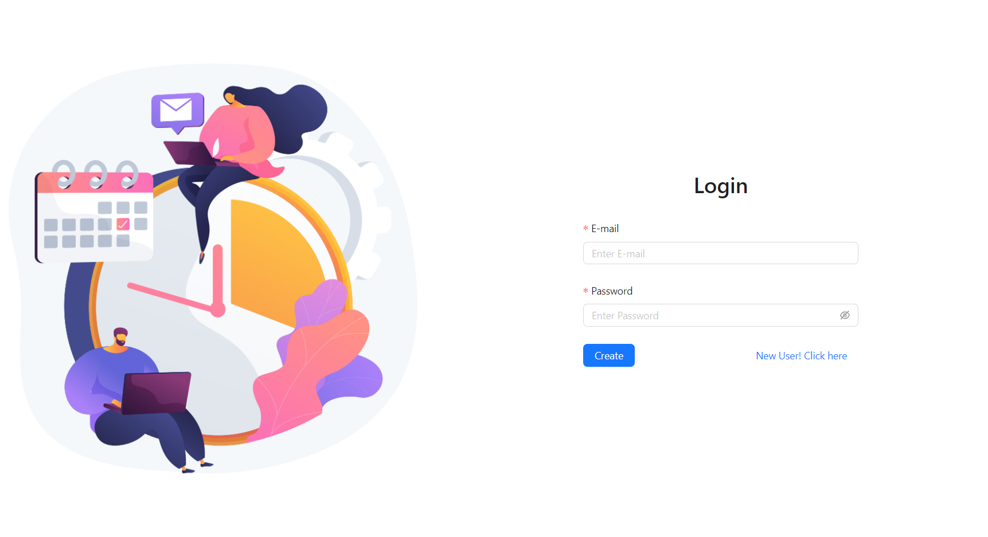

Slide 13


Slide 14
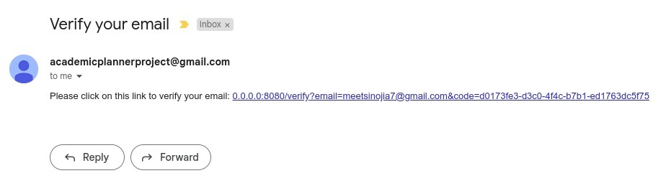

Slide 15
Future tasks
User profile creation. Profile creation with planned timings like classes and part time jobs and personal activity.
Calendar View. Recommendation providing for tasks like assignments, gym etc.
Continuous Deployment.
Continuous inspection of code smells using SonarQube and ESLint.

Slide 16
Thank you

